Slide 1
microservices

Slide 2
https://www.baeldung.com/resilience4j

Slide 3
Create 3 spring boot projects
Build movie catalogue service api
Build movie info service api
Build ratings data service api
Call 2 services from movie catalogue service
Optimize the code(implement in better way )

Slide 4
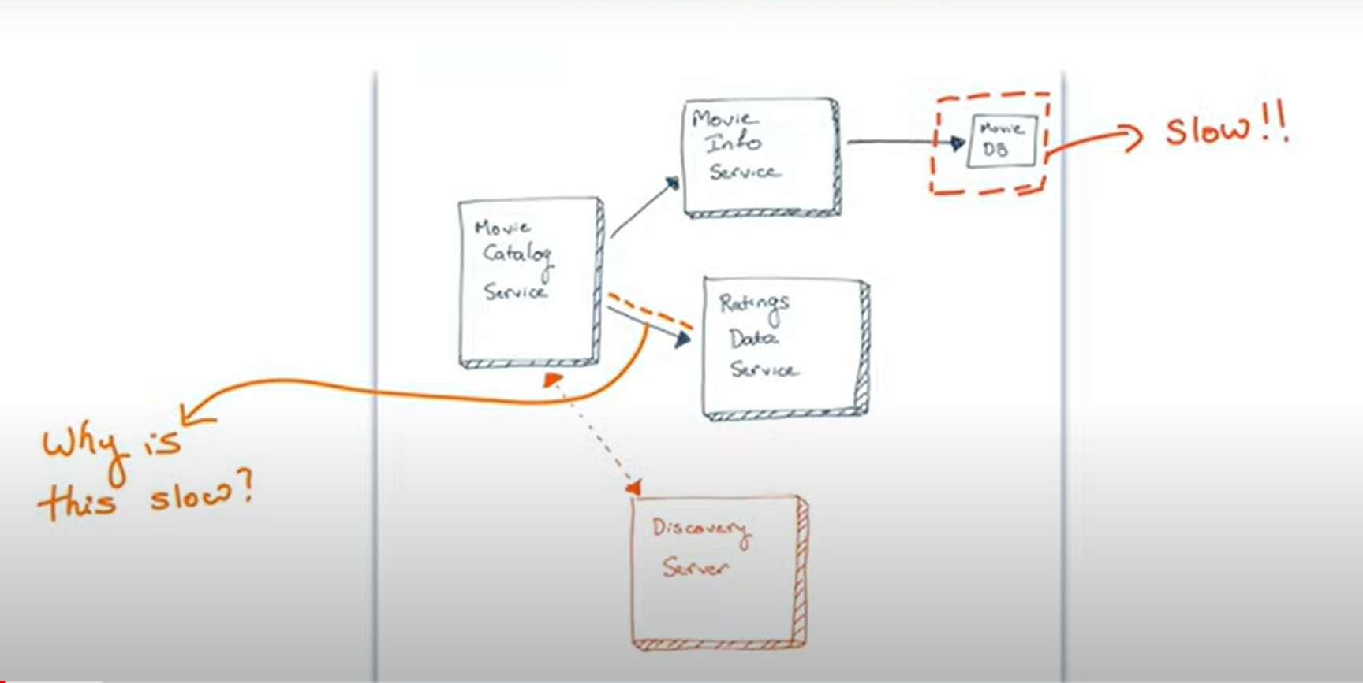

Slide 5
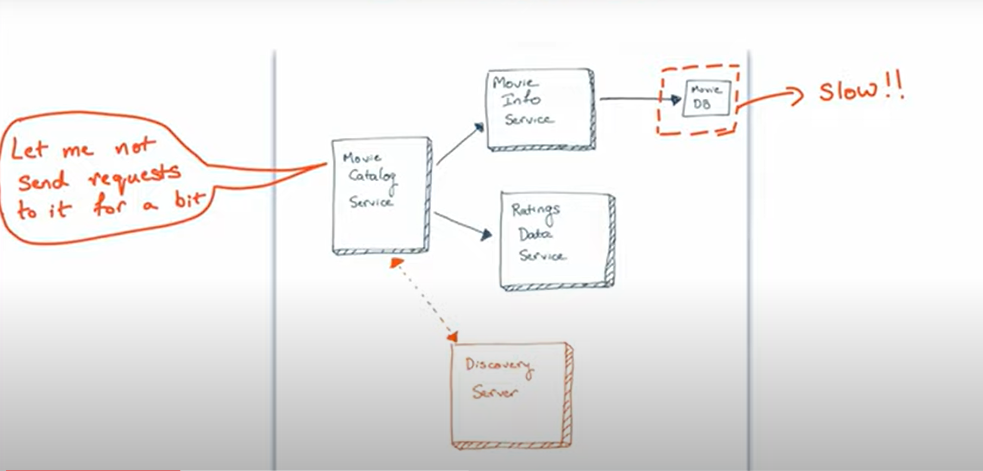
foood

Slide 6
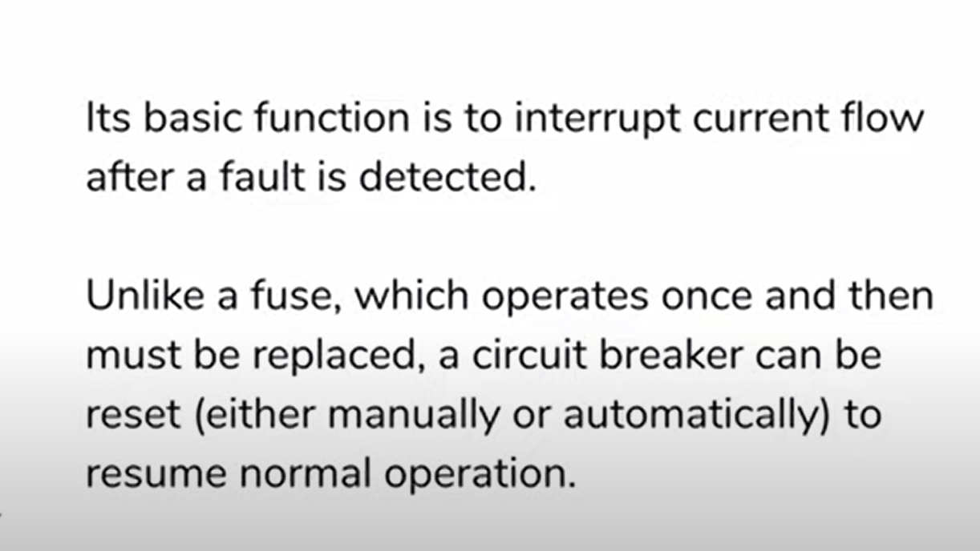
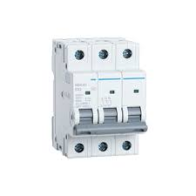
CIRCUIT BREAKER

Slide 7
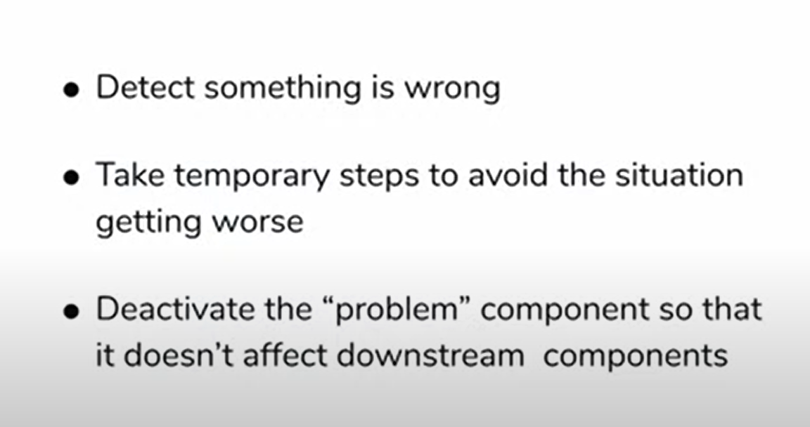
CIRCUIT BREAKER PATTERN

Slide 8
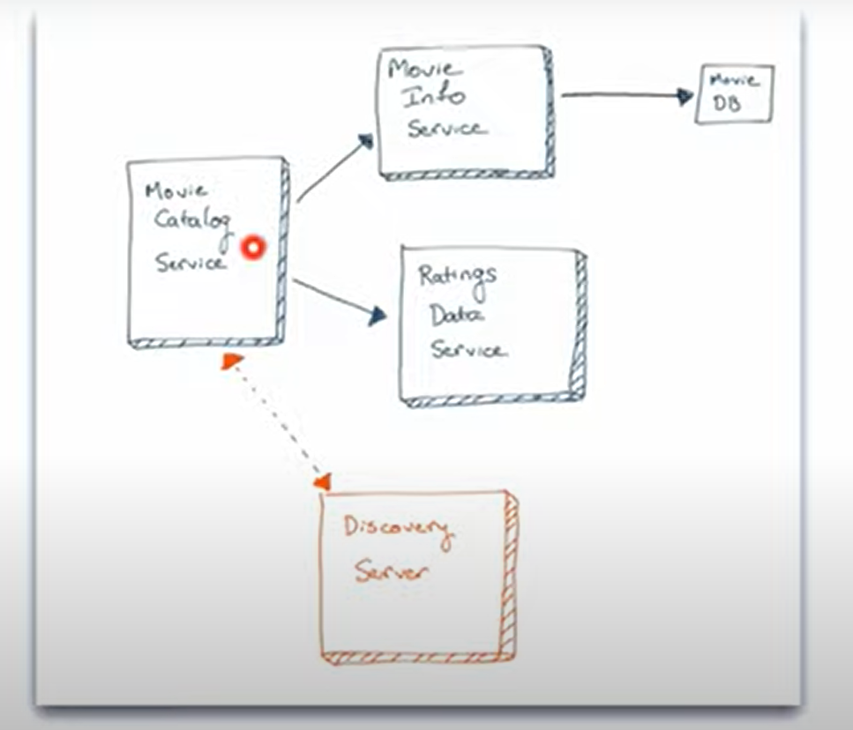

Slide 9
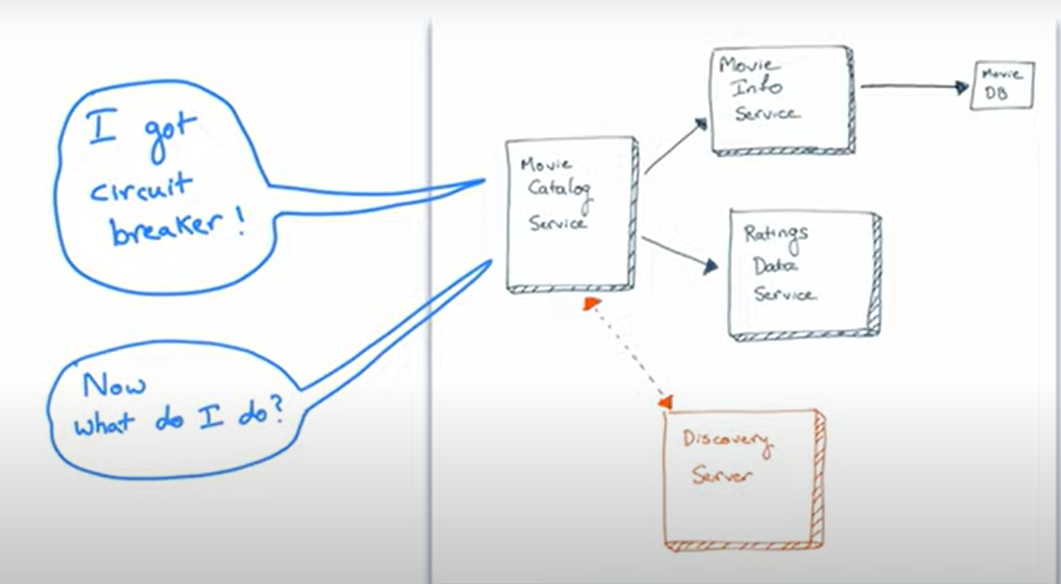

Slide 10
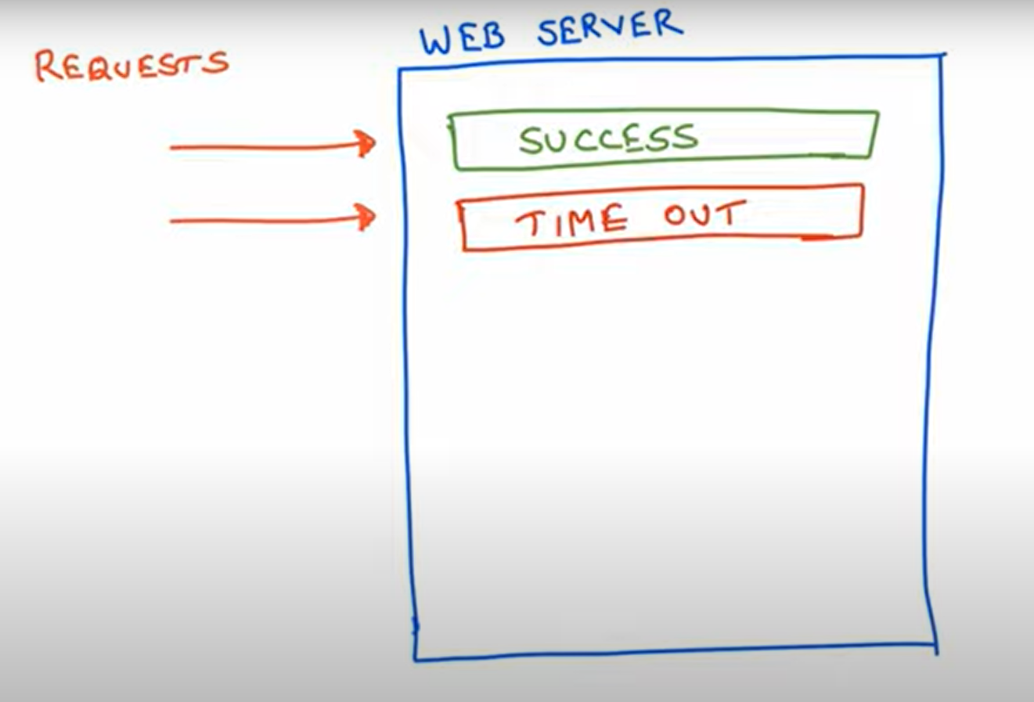

Slide 11
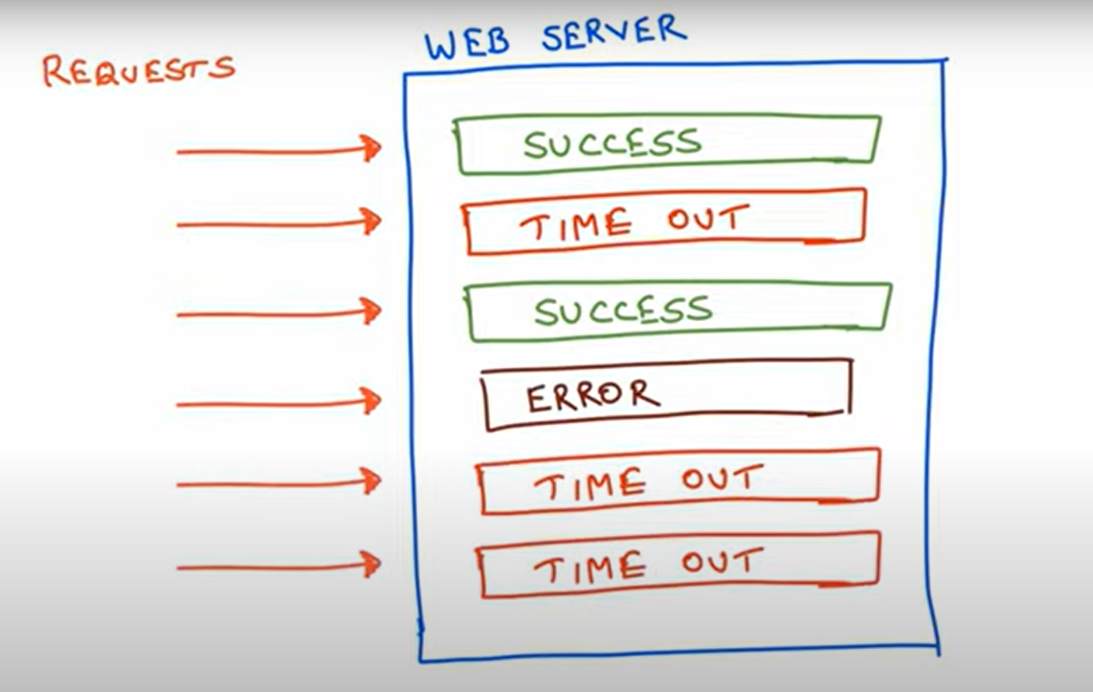

Slide 12
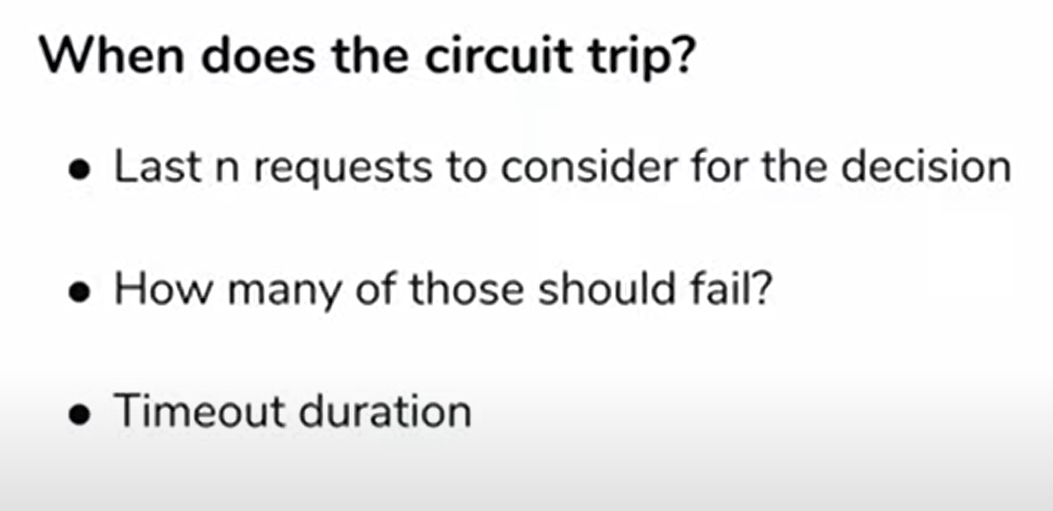
CIRCUIT BREAKER PARAMETERS

Slide 13
WHEN DOES CIRCUIT COMES BACK (UNTRIP)
How long after a circuit trip to try again?

Slide 14
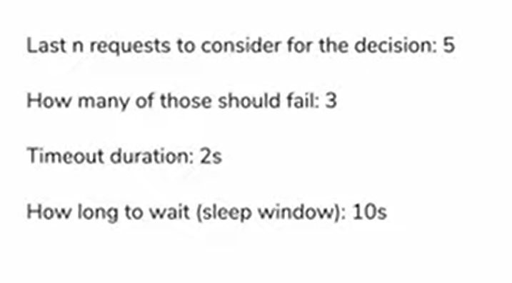
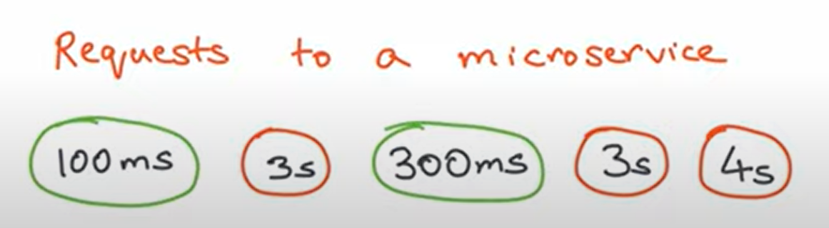
example:

Slide 15
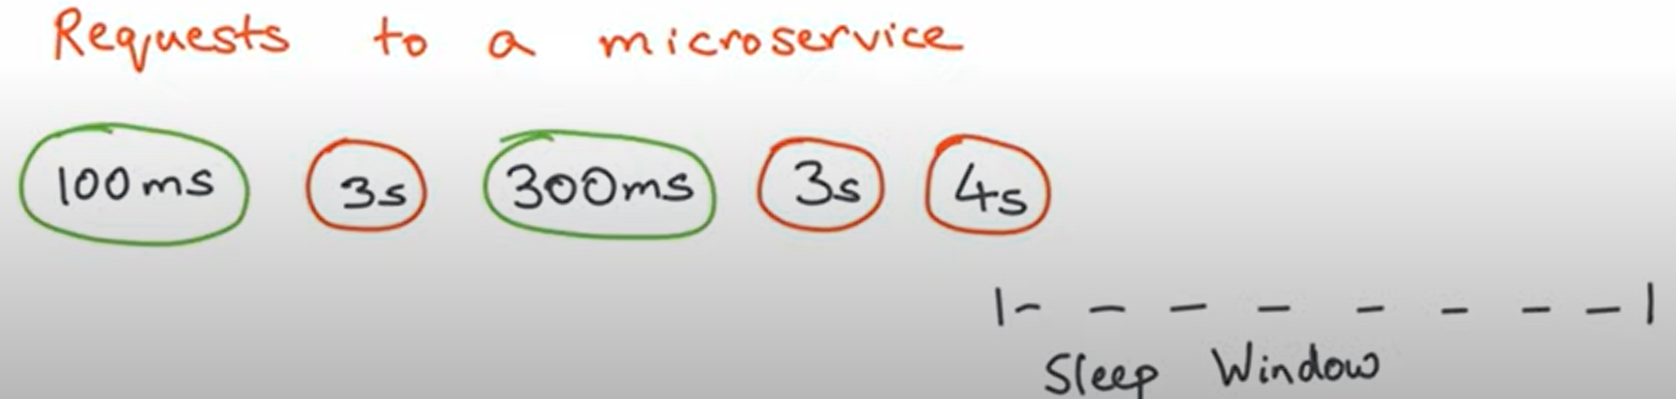
https://github.com/Netflix/Hystrix/wiki/configuration

Slide 16
HOW TO DECIDE NUMBER?
IT’S TRICKY
HIT AND TRIAL
DEPENDS ON MAINLY 2 -> HOW MANY REQUESTS COMING IN
HOW BIG YOU’RE THREAD POOL IS

Slide 17
CIRCUIT NEEDS TO BE TRIPPED ..
NEXT ?????????????????????
13

Slide 18
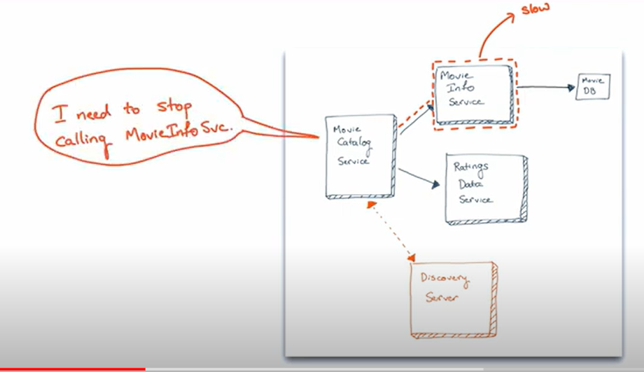

Slide 19
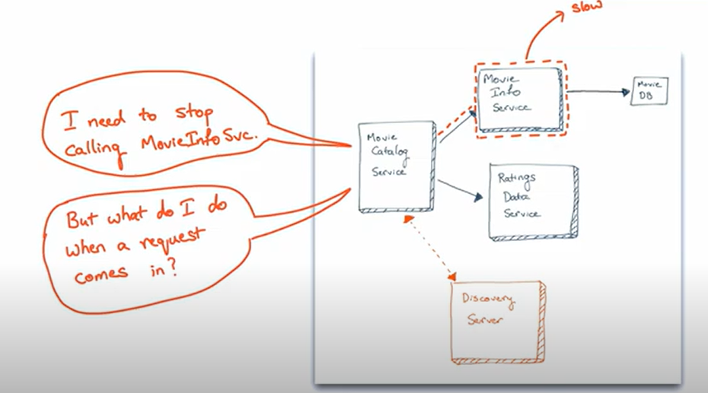

Slide 20
WE NEED A FALLBACK MECHANISM

Slide 21
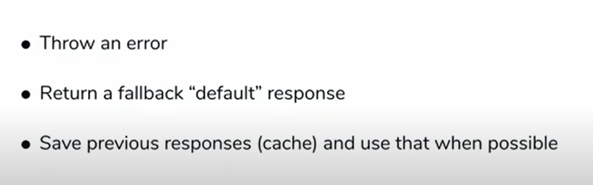
FALLBACK MECHANISM

Slide 23
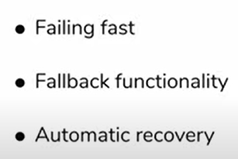
Why CIRCUIT BREAKERS?

Slide 24
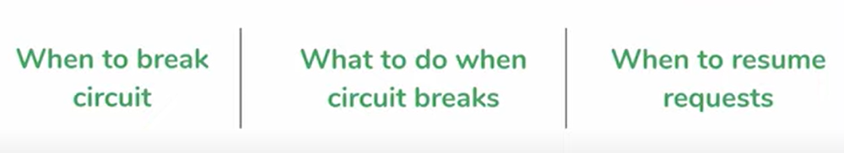
CIRCUIT BREAKER PATTERN

Slide 25
HYSTERIX

Slide 26
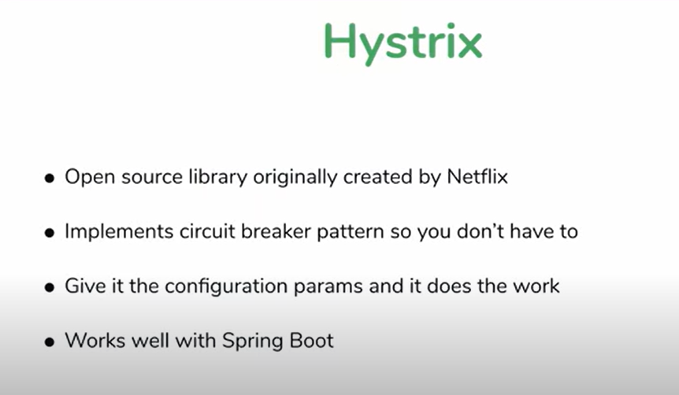
15

Slide 27
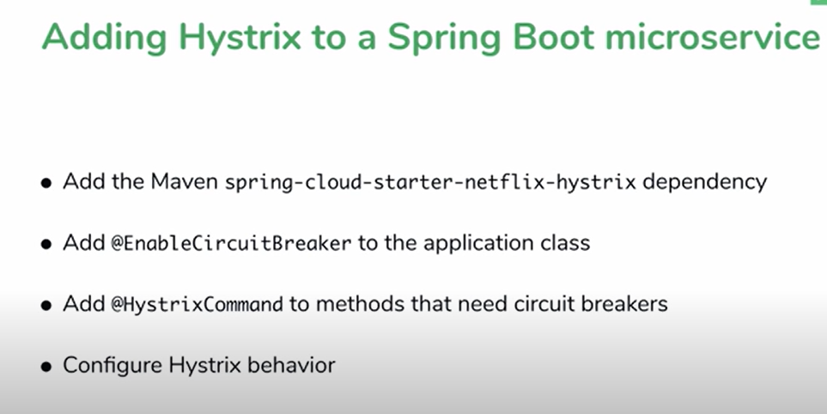
16

Slide 28
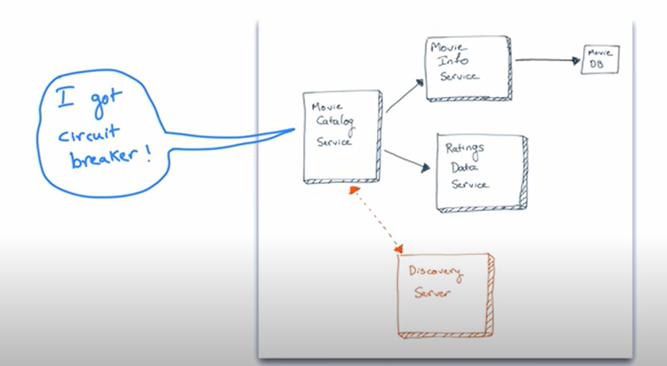

Slide 29
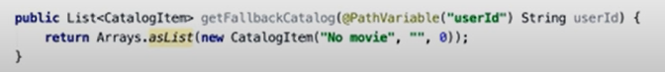
16

Slide 30
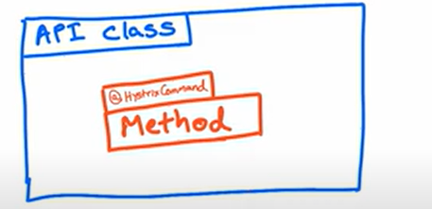
How does Hystrix work

Slide 31
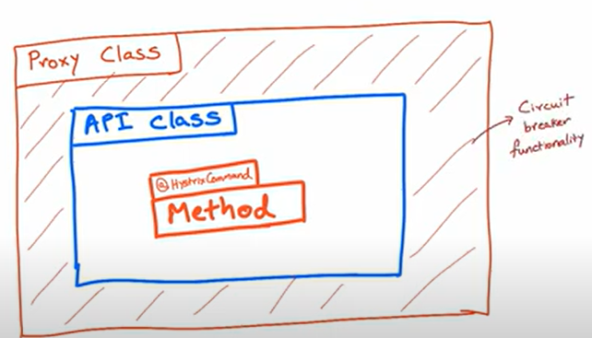

Slide 32
hysterix
Maintaining state, not actively developing state

Slide 33
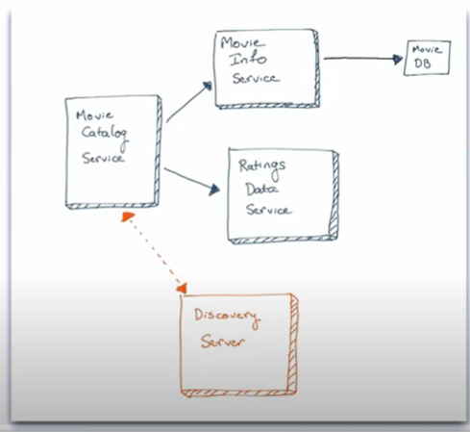
Problem with Hystrix proxy

Slide 34
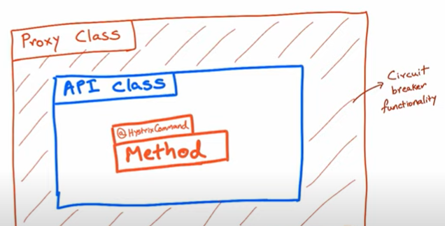
Granular, sep methods
Wraps around instance

Slide 35
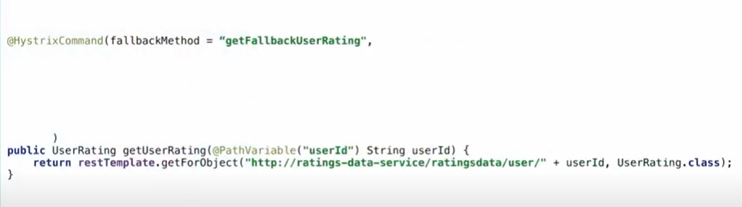
PARAMETERS

Slide 36
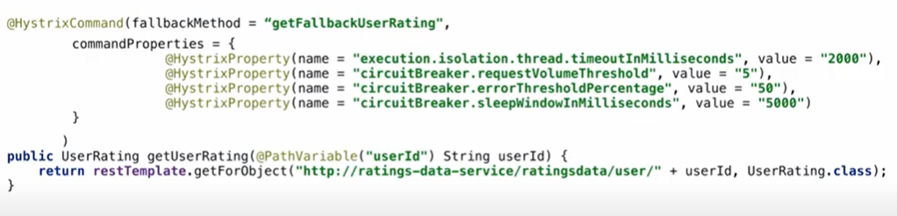
PARAMETERS

Slide 37
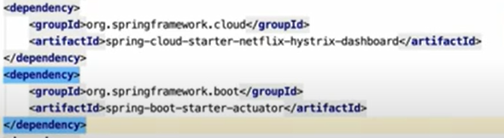
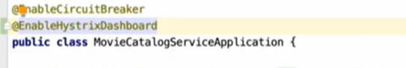
HYSTRIX DASHBOARD

Slide 38
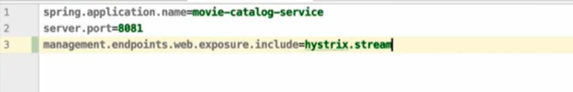

Slide 39
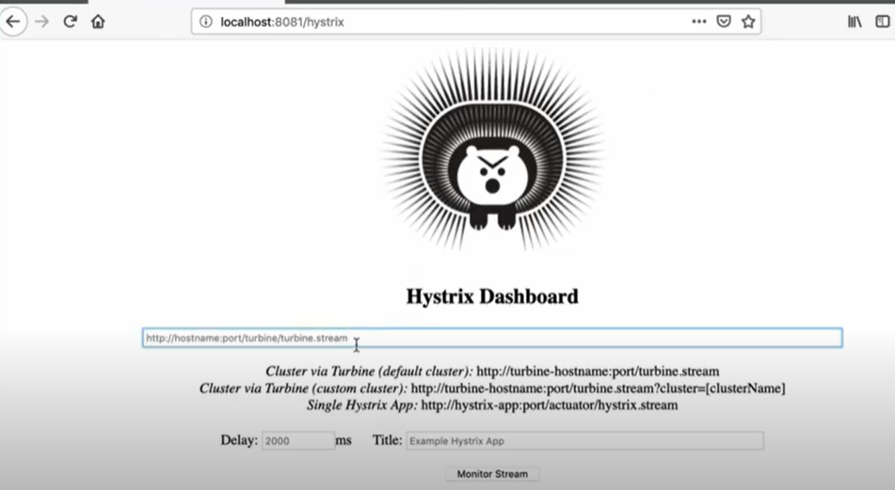

Slide 40
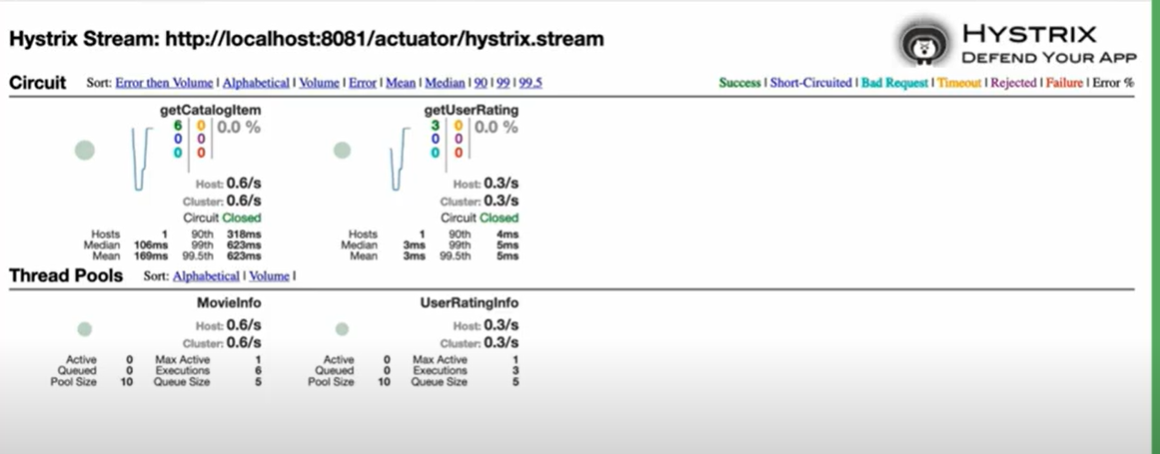

Slide 41
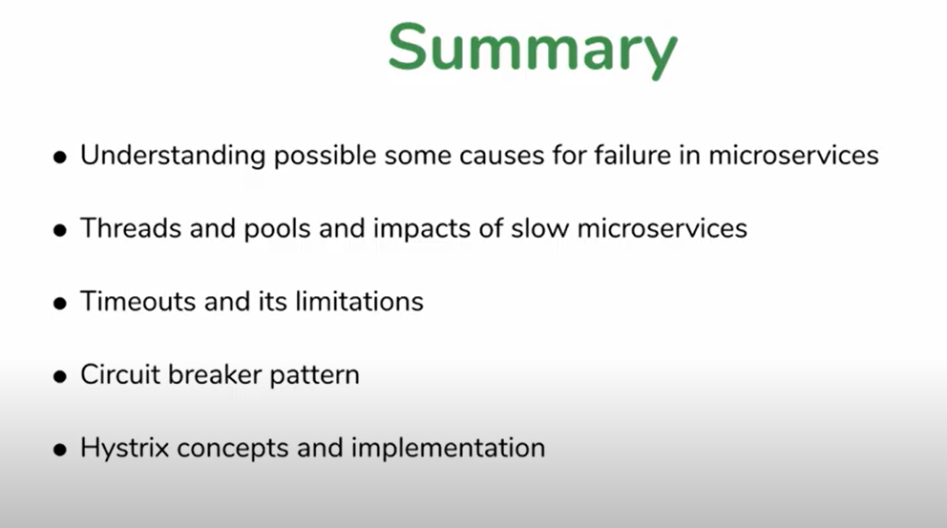

Slide 42
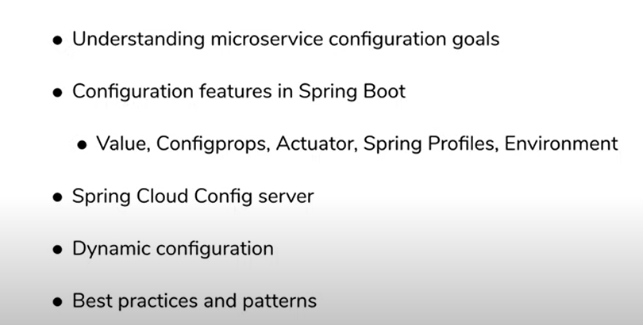

Slide 43
SPRING BOOT CONFIGURATIONS

Slide 44
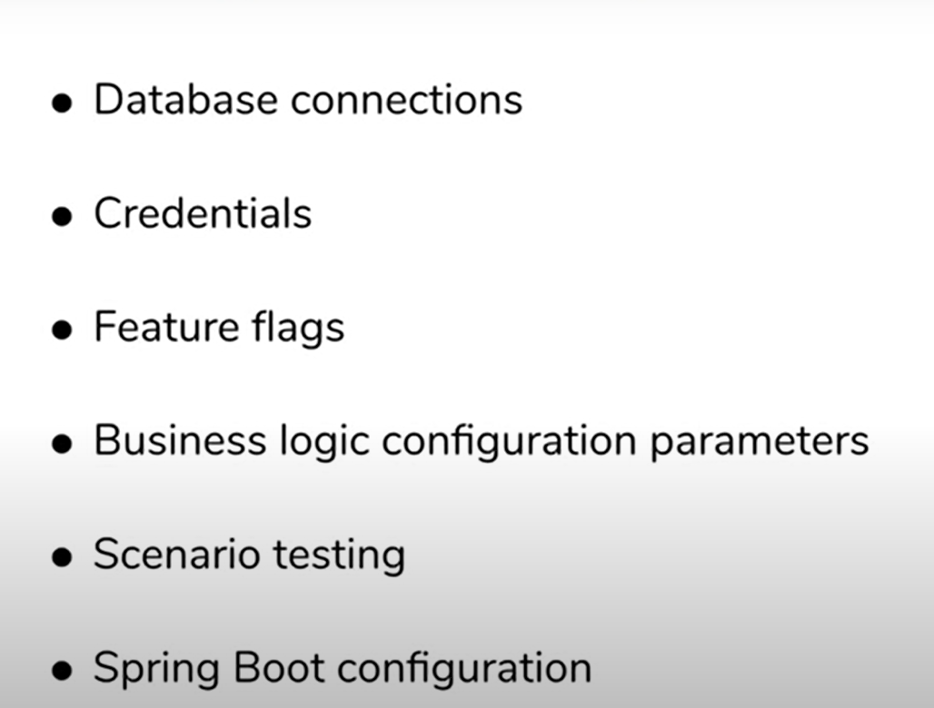
EXAMPLES

Slide 45
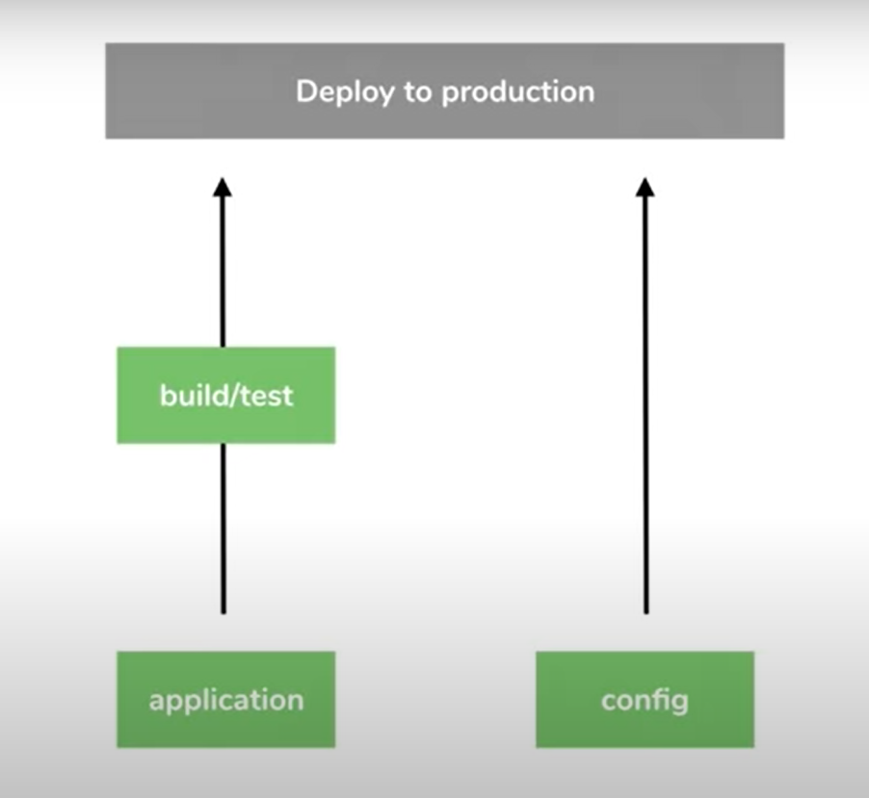

Slide 46
Xml FILES
XML FILES
YAML, PROPERTIES, JSON

Slide 47
Using property file config
Using property file config

Slide 48
Using external property sources with Spring Boot

Slide 49
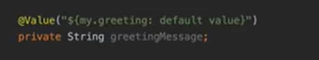
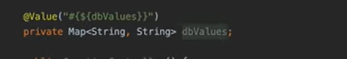
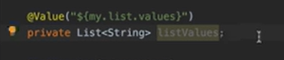
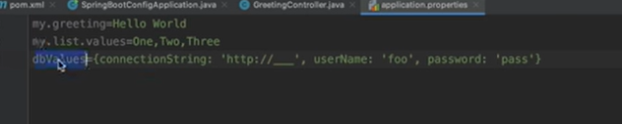
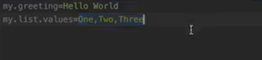

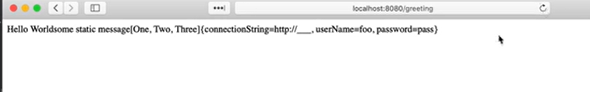
Three Value annotation tricks

Slide 50
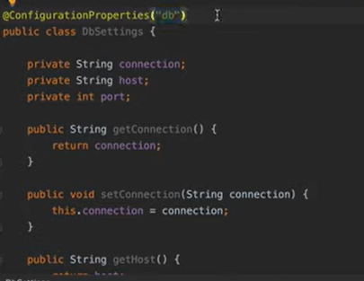
ConfigurationProperties
Pull up group of configurations @once
Create a class with getter, setter
@ConfigurationProperties(“mentionit”)
To create it as bean, @Configuration
Then, autowire it wherever needed.

Slide 51
Type check available. In config -> int, app.prop-> string, then error

Slide 52
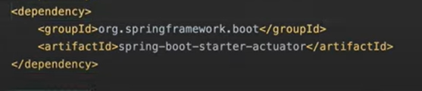
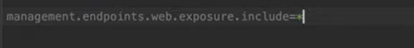
Spring boot actuator
/actuator/configprops
<dependency>
<groupId>org.springframework.boot</groupId>
<artifactId>spring-boot-starter-actuator</artifactId>
</dependency>
management.endpoints.web.exposure.include=*

Slide 53
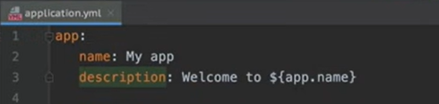
YAML
? Yet Another Markup Language
YAML ain’t markup language
Key value pair with : instead of =
Double quotes not required, it recognizes text as string, number
Nesting possible
Instead of . use :

Slide 54

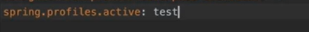
ENVIRONMENT SPECIFIc - spring profile
Different value based configurations, based on different environments
Profile as a set of configuration values,gotogether as group, &form values
https://www.baeldung.com/spring-profiles
Sdfdsf STEP: create a new profile and tell spring to use that

Slide 55



Slide 56
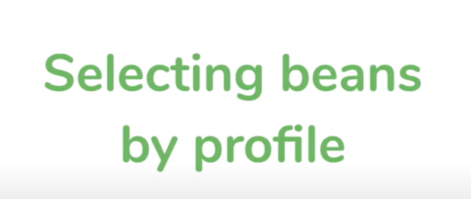
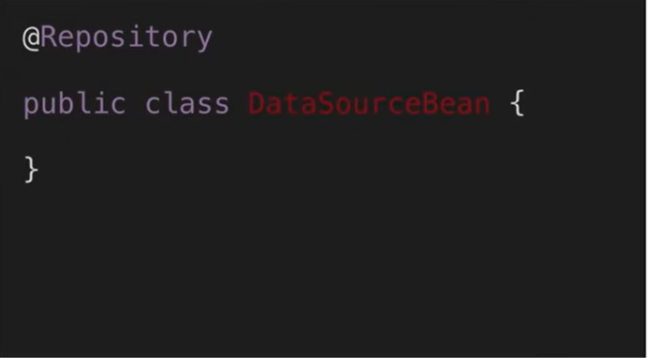


Slide 57



Slide 58

All beans instansiated

Slide 59


Slide 60

Using Environment object - Microservice configuration with Spring Boot

Slide 61


Slide 62

But, we shouldn’t be using it

Slide 63

Spring Cloud Config Server

Slide 64


Slide 65


Slide 66

OPTIONS AVAILABLE

Slide 68


Slide 69


Slide 70


Slide 71

Set up spring cloud config server from scratch

Slide 72

AFTER GENERATING,ADD ANNOTATION

Slide 73


Slide 74



C:\\Users\\user234\\Desktop\\config-git

Slide 75


Slide 76



Slide 77

Centralised, externalised config server

Slide 78


Setting up spring cloud config client

Slide 79

OR

Slide 80



Slide 81


To give yml specific to microservice
In your config git rpo,
In your config git rpo, add this yml and commit it

Slide 82


Go to microservice app.yml

Slide 83


Slide 84


Don’t have to start cloud config server, everytime
In your microservice, have actuator dependency

Slide 85


Slide 86


Slide 87


